Slide 1










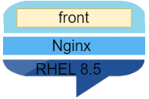
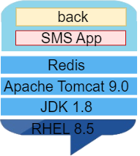


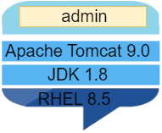
ACRC
권익위원회
ASP국민Call
환경청,
국가문화유산청
기상청
여성가족부
국토부
농촌진흥청
농림축산검역본부
acrc.call110.go.kr
192.168.100.25
asp.call110.go.kr
192.168.100.26
me.call110.go.kr
khs.call110.go.kr
192.168.100.30
molit.call110.go.kr
192.168.100.29
mogef.call110.go.kr
192.168.100.27
kma.call110.go.kr
192.168.100.28
rpqa.call110.go.kr
rda.call110.go.kr
192.168.100.31
ske-acrc-call110-1
ske-asp-call110-1
ske-me-khs-call110-1
ske-molit-call110-1
ske-mogef-call110-1
ske-kma-call110-1
ske-rda-apqa-call110-1
192.168.90.2
192.168.90.4
192.168.90.15
192.168.90.13
192.168.90.7
192.168.90.9
192.168.0.18
ske-acrc-call110-2
ske-asp-call110-2
ske-me-khs-call110-2
ske-molit-call110-2
ske-mogef-call110-2
ske-kma-call110-2
ske- rda-apqa -call110-2
192.168.90.3
192.168.90.5
192.168.90.16
192.168.90.14
192.168.90.8
192.168.90.10
192.168.0.19
acrc-palette-deploy-1
asp-palette-deploy-1
me-khs-palette-deploy-1
molit-palette-deploy-1
mogef-palette-deploy-1
kma-palette-deploy-1
rpa-apqa-palette-deploy-1
acrc-palette-deploy-2
asp-palette-deploy-2
me-khs-palette-deploy-2
molit-palette-deploy-2
mogef-palette-deploy-2
kma-palette-deploy-2
rpa-apqa-palette-deploy-2

