Slide 1


CommonDao
CommonDao
CommonDao
ControllerN
ServiceN
SQL Map
...
...
HttpRequest
Controller3
Service3
Query ID
JDBC
Dispatcher
Servlet
Map, VO
CommonDao
Database
(Oracle 11g)
Browser
Controller2
Service2
Map, VO
Filter
Controller1
Service1
Presentation Layer
Business Logic Layer
Data Access Layer

Slide 2


Client Tier
Business Tier
Data Tier
HttpRequest
JDBC
Browser
WAS
Database
Browser

Slide 3
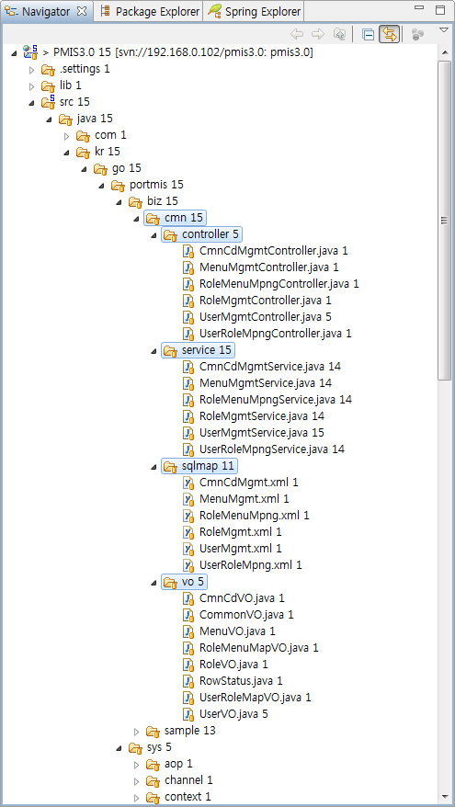
Controller
Service
개발자 개발영역
Sql Mapping Xml
Value Object

Slide 4
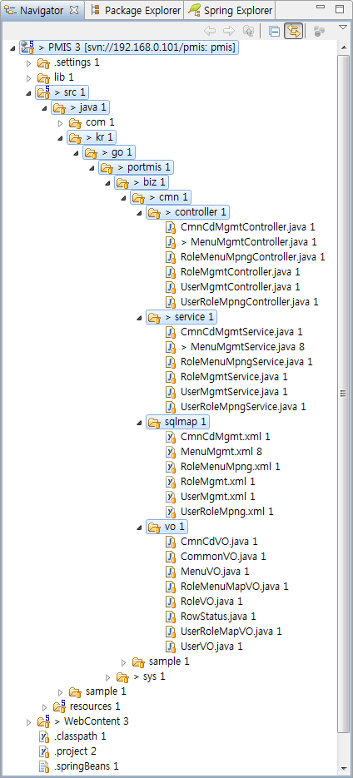
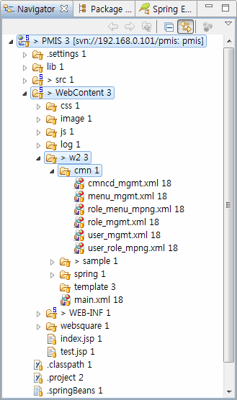
Controller
Websquare UI
Service
Sql Mapping Xml
Value Object

